Slide 1
Alternative Paradigm:
Concurrency
Module 5

Slide 2
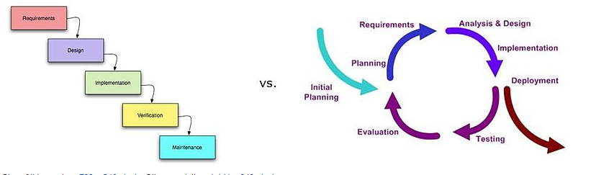
Concurrent
Concurrency means multiple computations are happening at the same time. ( in a network, one computer or multiple processors in same computer)
Sequential Vs Concurrent

Slide 3
Concurrency is essential in modern programming:
Web sites must handle multiple simultaneous users.
Mobile apps need to do some of their processing on servers (“in the cloud”).
Graphical user interfaces almost always require background work that does not interrupt the user.

Slide 4
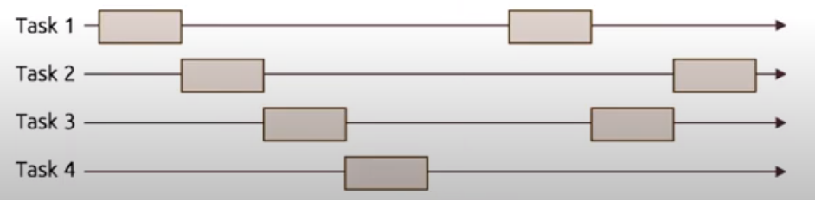
Concurrent programming
In programming terms, concurrent programming is a technique in which two or more processes start, run in an interleaved fashion through context switching and complete in an overlapping time period by managing access to shared resources e.g. on a single core of CPU

Slide 5
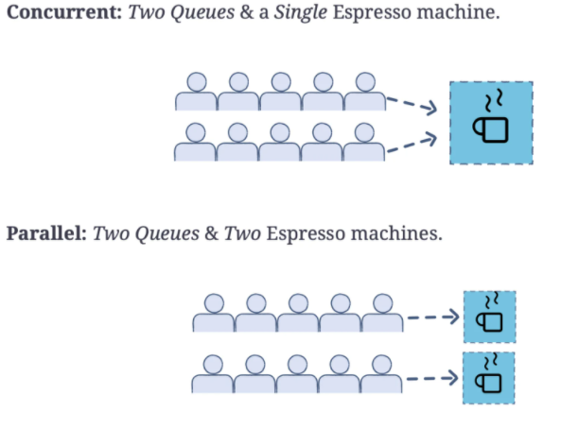
Concurrency Vs Parallelism

Slide 6
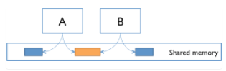
Two Models for Concurrent Programming
Shared memory: - In the shared memory model of concurrency, concurrent modules interact by reading and writing shared objects in memory.
Examples of the shared-memory model:
A and B might be two processors (or processor cores) in the same computer, sharing the same physical memory.
A and B might be two programs running on the same computer, sharing a common filesystem with files they can read and write.
A and B might be two threads in the same Java program (thread), sharing the same Java objects.

Slide 7

Message passing:-. In the message-passing model, concurrent modules interact by sending messages to each other through a communication channel. Modules send off messages, and incoming messages to each module are queued up for handling.
Examples :
A and B might be two computers in a network, communicating by network connections.
A and B might be a web browser and a web server – A opens a connection to B, asks for a web page, and B sends the web page data back to A.
A and B might be an instant messaging client and server.
A and B might be two programs running on the same computer whose input and output have been connected by a pipe, like ls | grep typed into a command prompt.

Slide 8
Processes, Threads, Time-slicing
Process.
A process is an instance of a running program that is isolated from other processes on the same machine. In particular, it has its own private section of the machine’s memory.
It makes the program feel like it has the entire machine to itself
Just like computers connected across a network, processes normally share no memory between them. A process can’t access another process’s memory or objects at all. Sharing memory between processes is possible on most operating system, but it needs special effort. By contr

Slide 9
Thread.
Just as a process represents a virtual computer, the thread abstraction represents a virtual processor. Making a new thread simulates making a fresh processor inside the virtual computer represented by the process. This new virtual processor runs the same program and shares the same memory as other threads in process.
Threads are automatically ready for shared memory, because threads share all the memory in the process. It needs special effort to get “thread-local” memory that’s private to a single thread.
It’s also necessary to set up message-passing explicitly, by creating and using queue data structures.

Slide 10
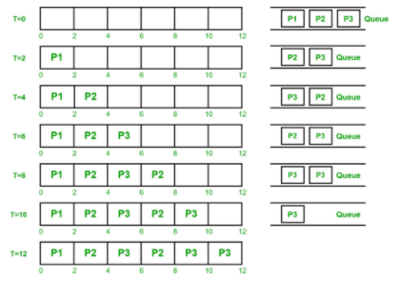
Time slicing
When there are more threads than processors, concurrency is simulated by time slicing, which means that the processor switches between threads.

Slide 11
Multitasking is when multiple processes share common processing resources such as a CPU.
Multi-threading extends the idea of multitasking into applications where you can subdivide specific operations within a single application into individual threads. Each of the threads can run in parallel.
The OS divides processing time not only among different applications, but also among each thread within an application.

Slide 12
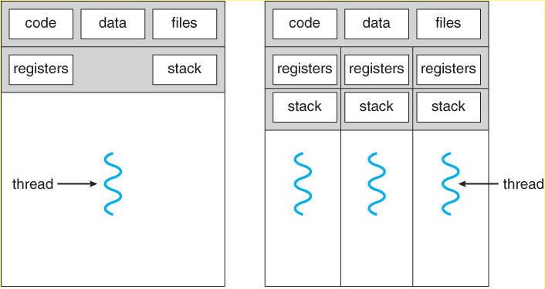
Concurrency in C++
In C++, the two most common ways of implementing concurrency are through multithreading and parallelism.
C++ multithreading involves creating and using thread objects, seen as std::thread in code, to carry out delegated sub-tasks independently.
Notes:
https://www.educative.io/blog/modern-multithreading-and-concurrency-in-cpp

Slide 13
std::thread is the thread class that represents a single thread in C++.
To start a thread we simply need to create a new thread object and pass the executing code to be called (i.e, a callable object) into the constructor of the object.
Once the object is created a new thread is launched which will execute the code specified in callable.
A callable can be either of the three
A function pointer
A function object
A lambda expression
After defining callable, pass it to the constructor.

Slide 14
Concurrency in Java
Life Cycle
How to create Threads
Thread methods

Slide 15
Race Condition

Slide 16
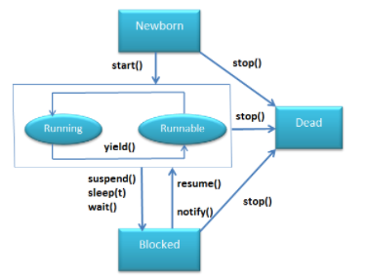
LifeCycle

Slide 17
Create Threads
Two ways to create a thread:
By extending Thread class
By implementing Runnable interface.
Differences between extending Thread class and implementing Runnable interface:
When we extend Thread class, we can’t extend any other class even we require and When we implement Runnable, we can save a space for our class to extend any other class in future or now.
When we extend Thread class, each of our thread creates unique object and associate with it. When we implements Runnable, it shares the same object to multiple threads.

Slide 18
Thread Methods
start() – Starts the thread.
getState() – It returns the state of the thread.
getName() – It returns the name of the thread.
getPriority() – It returns the priority of the thread.
sleep() – Stop the thread for the specified time.
join() – Stop the current thread until the called thread gets terminated.

Slide 19
Difference in C++ and Java
C++ does not provide built-in support for threads, whereas Java support threads implicitly. Though in the latest implementation of C++11, it does have support for threads as well.
The difference is the lack of templates and operator overloading, and the fact you need to call start() on Java's Thread objects.

Slide 20
References
Text Book :
Scott M L, Programming Language Pragmatics, 3rd Edn., Morgan Kaufmann Publishers, 2009 [Chapters: 12.1 and 12.2]

